Slide 1
System Analysis and Project Management – Process and Data Modeling
Prepared By - Vesh Raj Joshi

Slide 2
Process and Data Model
What are process modeling?
Process is an activity or function performed for a specific business reason. Business process contains business logics or business rules.
Process modeling is a formal way of representing how a business system operates.
Illustrates the activities that are performed and how data moves among them.
What is DFD(Data flow diagram)?
Data flow diagramming is a technique that diagrams the business processes and the data that pass among them. Data flow diagrams (DFDs) are to describe the to-be system’s interactions with its environment, processes, flows of data, and data stores.

Slide 3
Types of Process models
Logical Process models
Processes models describe processes without suggesting how they are conducted. Logical process models are abstract in nature regarding physical existance – they did not tell anything about how information is being collected; platform to be executed, and whether the output is being stored.
Physical Process models
Process models provide information that is needed to build the system. These physical details are defined during the design phase when these logical models are refined into physical models, which provide information that is needed to ultimately build the system.

Slide 4
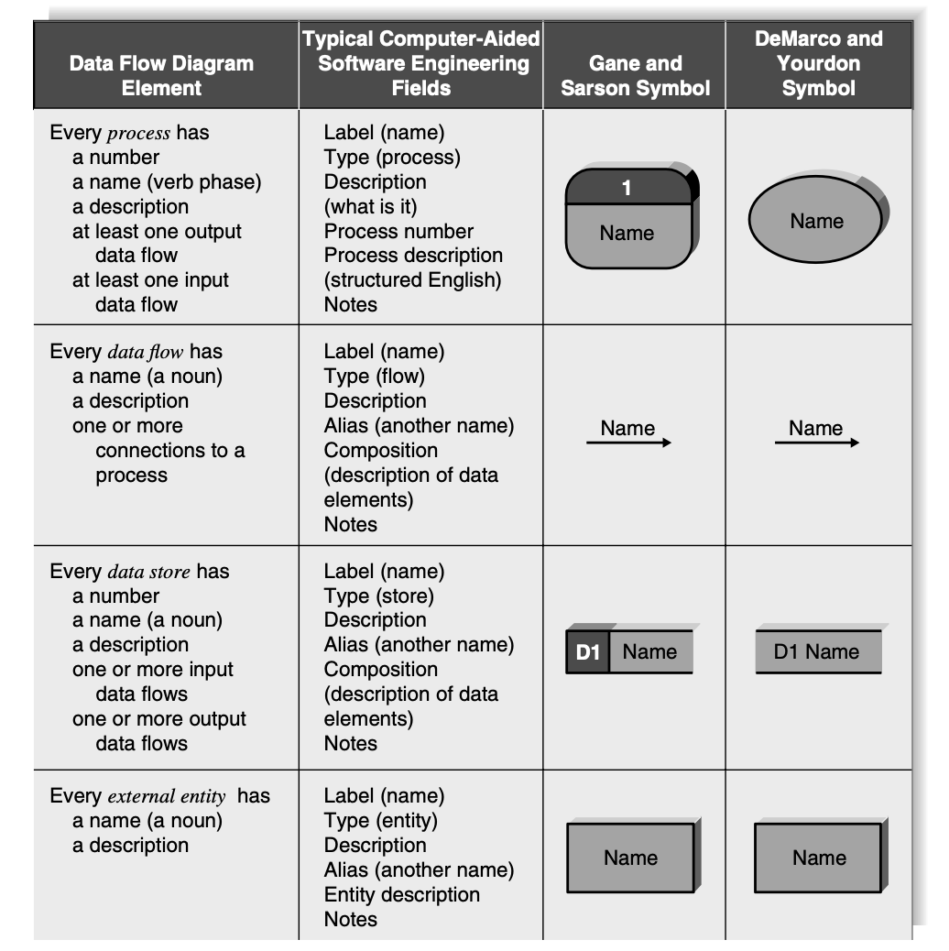
Data Flow Diagram Components

Slide 5
Data Flow Diagram Components
Process
An activity or function performed for a specific business reason
Manual or computerized
Every process has name, number and set of input and output
Name starts with verb and ends with noun
Data flow
A single piece of data or a logical collection of data
Always start or ends with at a process
Data store
A collection of data that stored in some way
Data flowing out is retrieval from the data store
Data flowing in update or is added to the data store

Slide 6
Data Flow Diagram Components
External Entity
A person or organization or system that is external to the system but interacts with it.
External entities provide data to the system or receive data from the system and serve to establish the system boundaries.

Slide 7
Using DFD to Define Business Processes
Decomposition
Is the process of respresenting the system in a heirarchy of DFD diagrams.
Child diagrams show a protion of the parent diagram in a greater detail
Balancing
Involve ensuring that information presented at one level of a DFD is accurately represented in next level DFD.

Slide 8
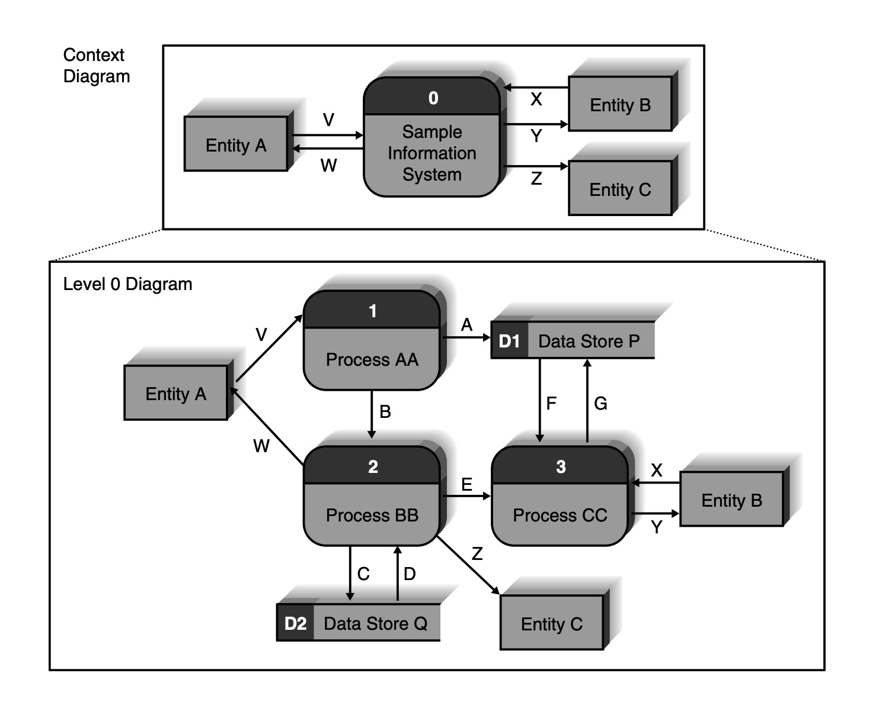
Using DFD to Define Business Processes - Decomposition

Slide 9
Levels of DFD
Context Diagram
Top level DFD is in business process model is context diagram – shows the entire system in context with its environment.
The context diagram shows the overall business process as a single process (i.e., the system itself) and shows the data flows to and from external entities.
Data stores are not included on the context diagram. If the system uses data from or supplies data to another independent information system, that system should be shown as an external entity, not a data store.

Slide 10
Levels of DFD
Level 0
The next level in DFD hierarchy diagram is level 0.
The level 0 diagram shows all the major processes at the first level of numbering, the data stores, external entities, and data flows among them.
The purpose of the level 0 DFD is to show all the major high-level processes of the system and how they relate to each other and to stored data.
All process models have one and only one level 0 DFD.
Balancing comes in to picture to finalize the DFD level 0.

Slide 11
Levels of DFD
Level 1
Each process on the level 0 DFD must be decomposed into a more explicit DFD, called a level 1 diagram, or level 1 DFD, which shows how it operates in greater detail.
Shows all the internal processes that comprise a single process on the level 0 diagram
Shows how information moves from and to each of the processes
If a parent process is decomposed into, for example, three child processes these three child processes wholly and completely make up the parent process.

Slide 12
Levels of DFD
Level 2
If any of the processes in the level 1 diagram appear to be “busy” with multiple inflows and out- flows, it may be appropriate to decompose that process into a child diagram.
The next level under level 1 would be labeled as level 2, and so forth.
The ultimate goal is to decompose a process so that each child process performs one essential task, not multiple tasks.

Slide 13
Alternative data flows
Where a process can produce different data flows given different conditions
We show both data flows and use the process description to explain why they are alternatives
Scenario - a quality-control process could produce a quality-approved widget or a defective widget, the customer may or may not approve the order modification. How do you show these alternative paths in the DFD? The answer is that you show both data flows and use the process description to explain that they are alternatives.

Slide 14
Process Descriptions
The purpose of process descriptions is to explain what the process does and provide additional information that the DFD does not provide
Text-based process descriptions provide more information about the process than the DFD alone
If logic underlying the process is quite complex, more detail may be needed in the form of
Structured English
Decision Trees
Decision tables

Slide 15
Creating Data Flow Diagrams
Integrating Scenario Description
DFDs start with the use cases and requirements definition
Generally, the DFDs integrate the uses cases
Names of use case become the processes
Inputs and outputs become data flows
Small data inputs and outputs are combined into single flow.

Slide 16
Creating Data Flow Diagrams
Steps in Building DFDs
Build the context diagram
Create DFD fragment to each use case
Organize DFD fragments into level 0 diagram
Dcompose level 0 processes into level 1 diagrams as needed; decompose level processes into level 2 diagrams as needed;
Validate DFDs with user to ensure completeness and correctness

Slide 17
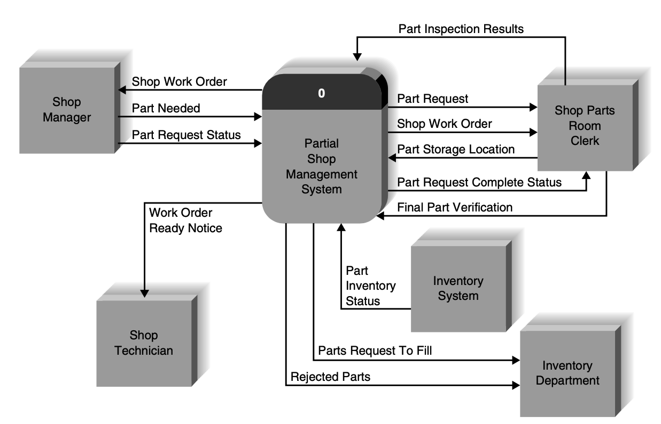
Creating Data Flow Diagrams
Creating Context Diagram
Draw one process representing the entire system(process 0)
Find all inputs and outputs listed at the top of the use cases that come from or go to external entities; draw as data flows
Draw in external entities as the source or destination of the data flows.

Slide 18
Creating Data Flow Diagrams
Creating DFD fragments
Each use case is converted into one DFD fragment
Number the process the same as the use case number
Change process into verb phrase
Design the processes from the viewpoint of the organization running the system.

Slide 19
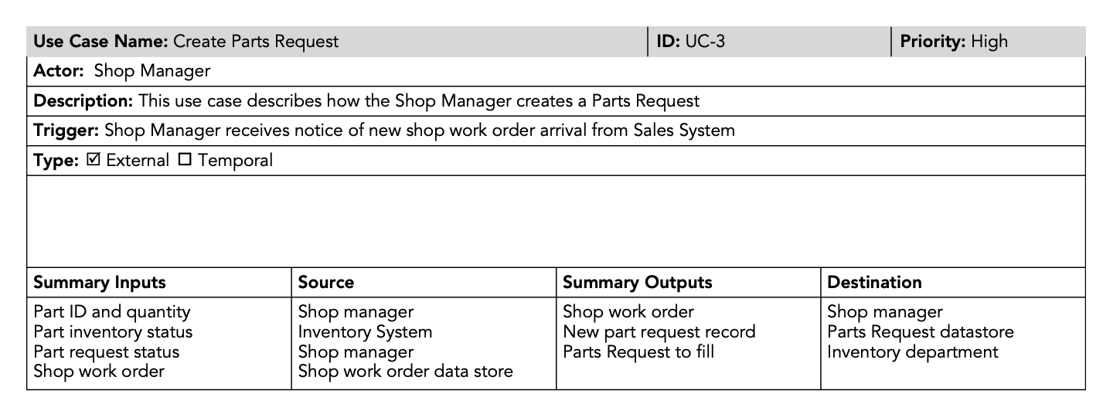
Creating Data Flow Diagrams
Creating DFD fragments

Slide 20
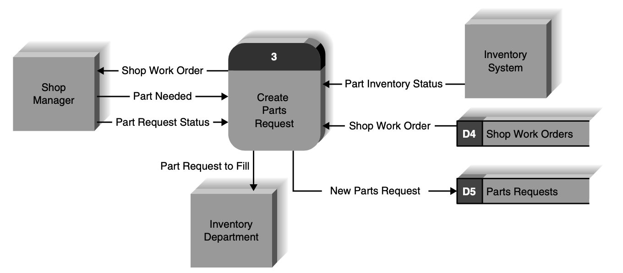
Creating Data Flow Diagrams
Creating DFD fragments

Slide 21
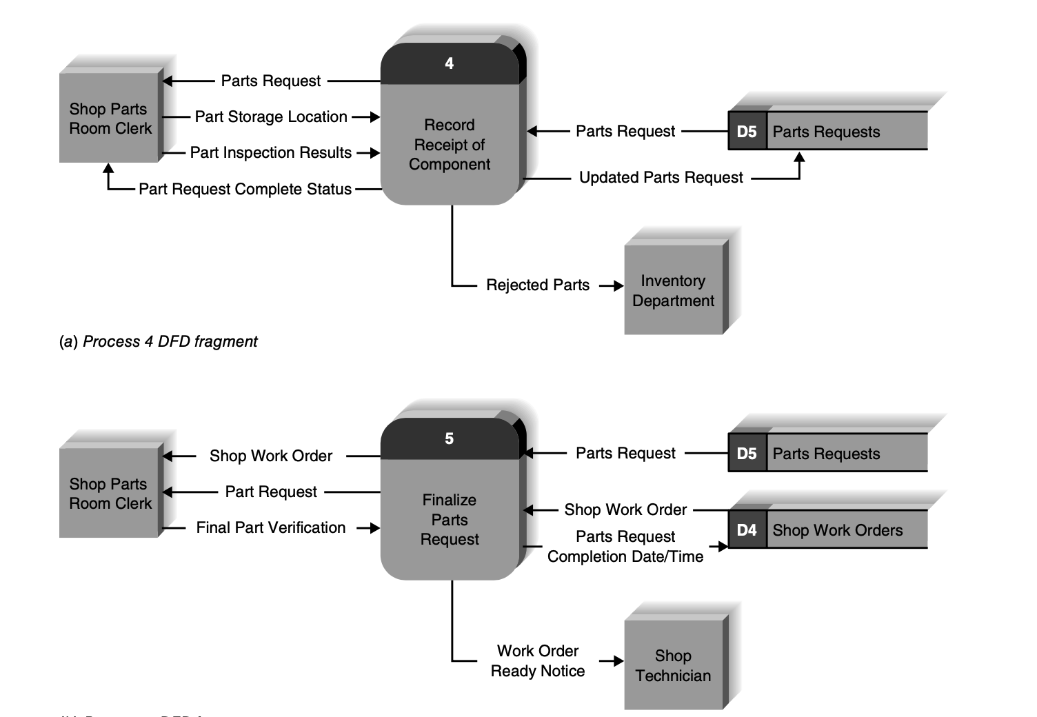
Creating Data Flow Diagrams
Creating DFD fragments

Slide 22
Creating Data Flow Diagrams
Creating Level 0
Combine all of the DFD fragments into one diagram.
Move from top to bottom left to right
Minimized corssed lines
Iterate as needed
DFDs are often drawn many times before being finished, even with very experienced system analyst
System analyst draw it once to understand the pattern of processes , data flows, data stores, and external entities and then draw it a second time on a fresh sheed of paper to make it easier to understand and to reduce the numer of data flows that cross.

Slide 23
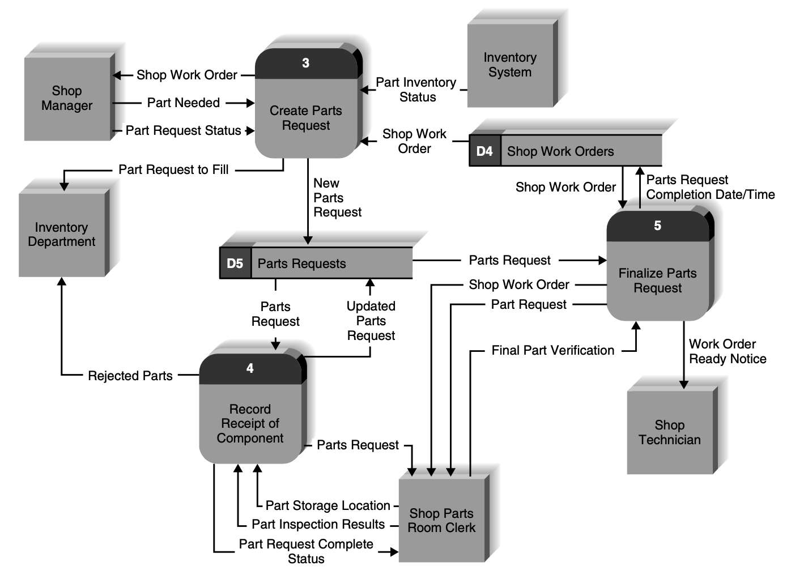
Creating Data Flow Diagrams
Creating Level 0

Slide 24
Creating Data Flow Diagrams
Creating Level 0

Slide 25
Creating Data Flow Diagrams
Creating Level 1
Each use case is turned into its own DFD
Take the steps listed on the use case and depict each as a process on the level DFD
Inputs and outputs listed on use case become data flows on DFD
Include sources and destinations of data flows to processes and stoers with in the DFD
May also include external entires for clarity

Slide 26
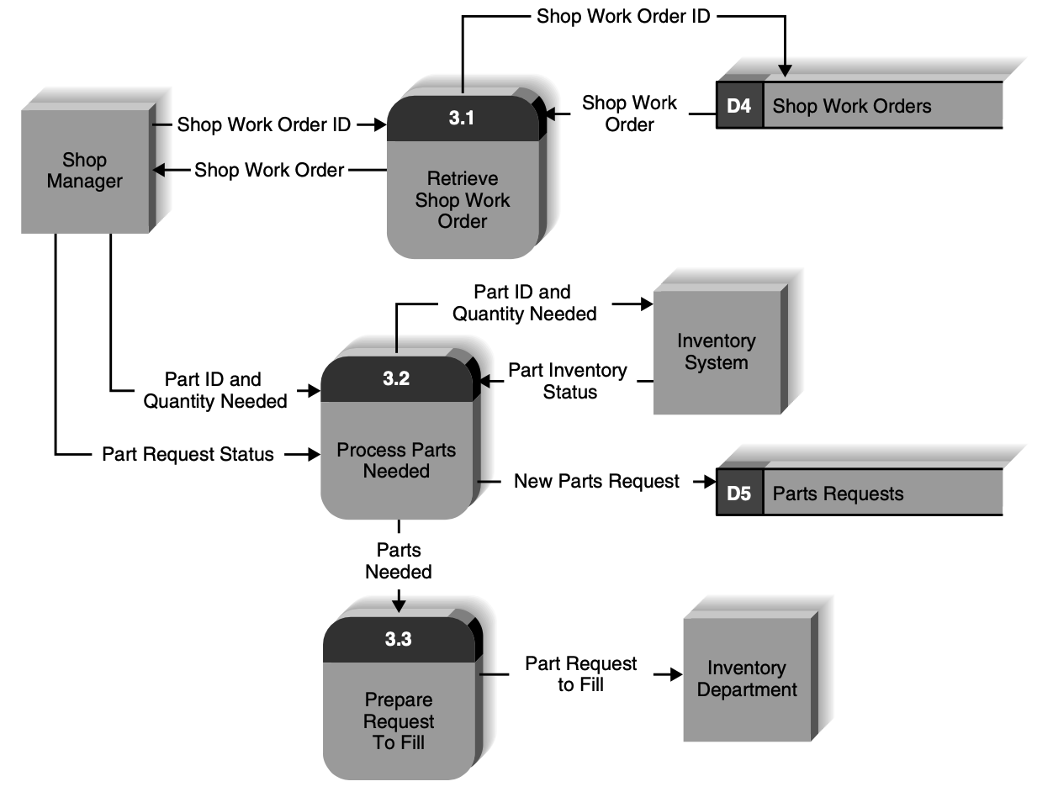
Creating Data Flow Diagrams
Creating Level 1

Slide 27
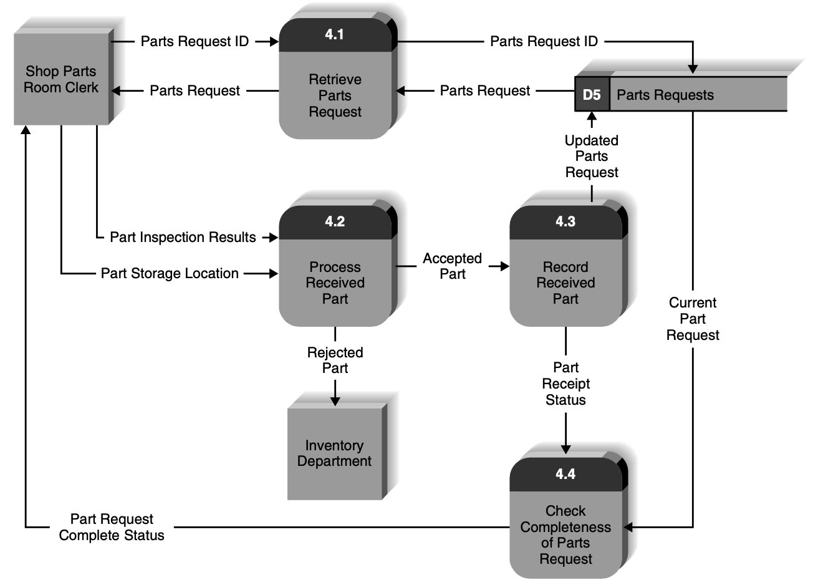
Creating Data Flow Diagrams
Creating Level 1

Slide 28
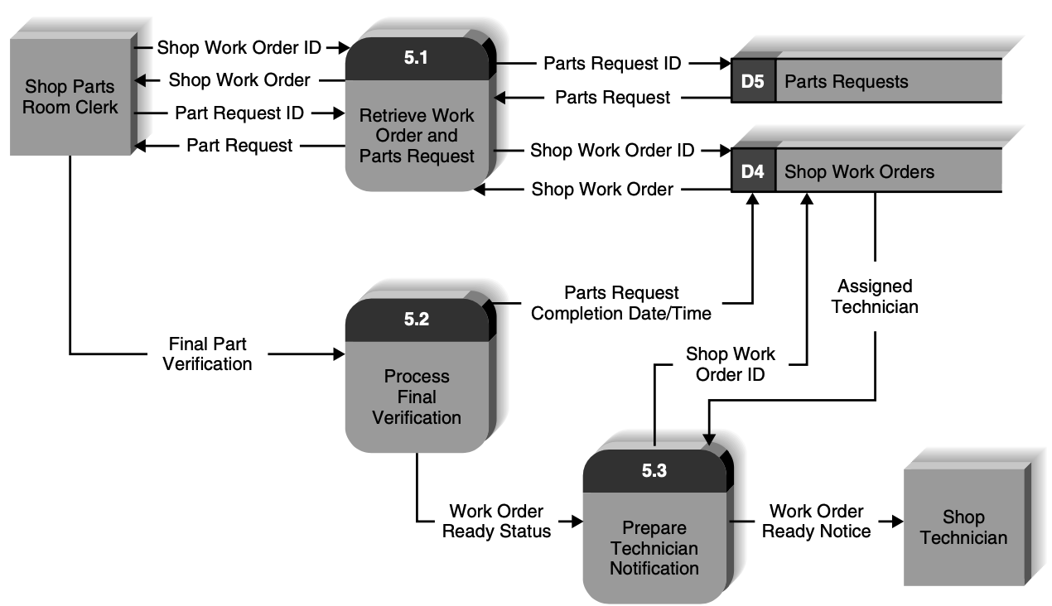
Creating Data Flow Diagrams
Creating Level 1

Slide 29
Validating the DFD
Syntax errors- diagram follows the rules
Assure correct DFD structure
Check each process for
A unique name: action verb phrase; number description
At least one input data flow
At least one output data flow
Output data flow names usually different than input data flow name
Between 3 to 7 processes per DFD
Check each data flow for
A unique name: noun; description
Connects to at least one process
Shown only one direction (no two headed arrow)
A minimum number of crossed lines

Slide 30
Validating the DFD
Syntax errors- diagram follows the rules
Check each data store for for
A unique name: noun; description
At least one input data flow
At least one output data flow
Check each external entity for
A unique name: noun; description
At least one input or ougput data flow
Context diagram
Every set of DFDs must have one Context Diagram
View Point
There is a consistent viewpoint for the entire set of DFDs

Slide 31
Validating the DFD
Decomposition
Every process is wholly and complete described by the processes on its children DFDs.
Balance
Every data flow, data store, external entity on a higher level DFD is whown on the lower level DFD that decomposes it. No data stores, data flows appear on the lower level DFDs that do not appear on the their parent DFD.

Slide 32
Validating the DFD
Semantic Error
Diagram conveys correct meaning
Assure accuracy of DFD relative to actual/desired business processes.
To verify correct representation, use
User walkthroughs
Role-play processes
Examine lowest level DFDs to ensure consistent decomposition
Examine. Names carefully to ensure consistent use of terms

Slide 33
Exercise of DFD
Using the example of a retail clothing store in a mall, list relevant data flows, data stores, processes, and sources/sinks. Observe several sales transactions – Goods sold, log goods inventory, sales log and generate management reports and those reports for store manager. Customer will make payment and get receipt from the mall. Draw a context diagram and a level-0 diagram that represent the selling system at the store. Explain why you chose certain elements as processes versus sources/sinks.

Slide 34
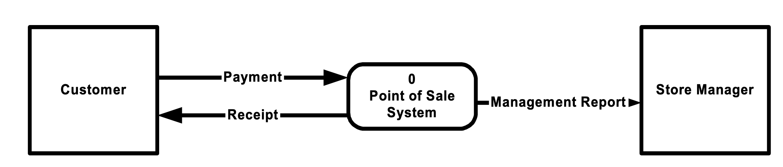
Exercise of DFD
Suggested context diagram

Slide 35
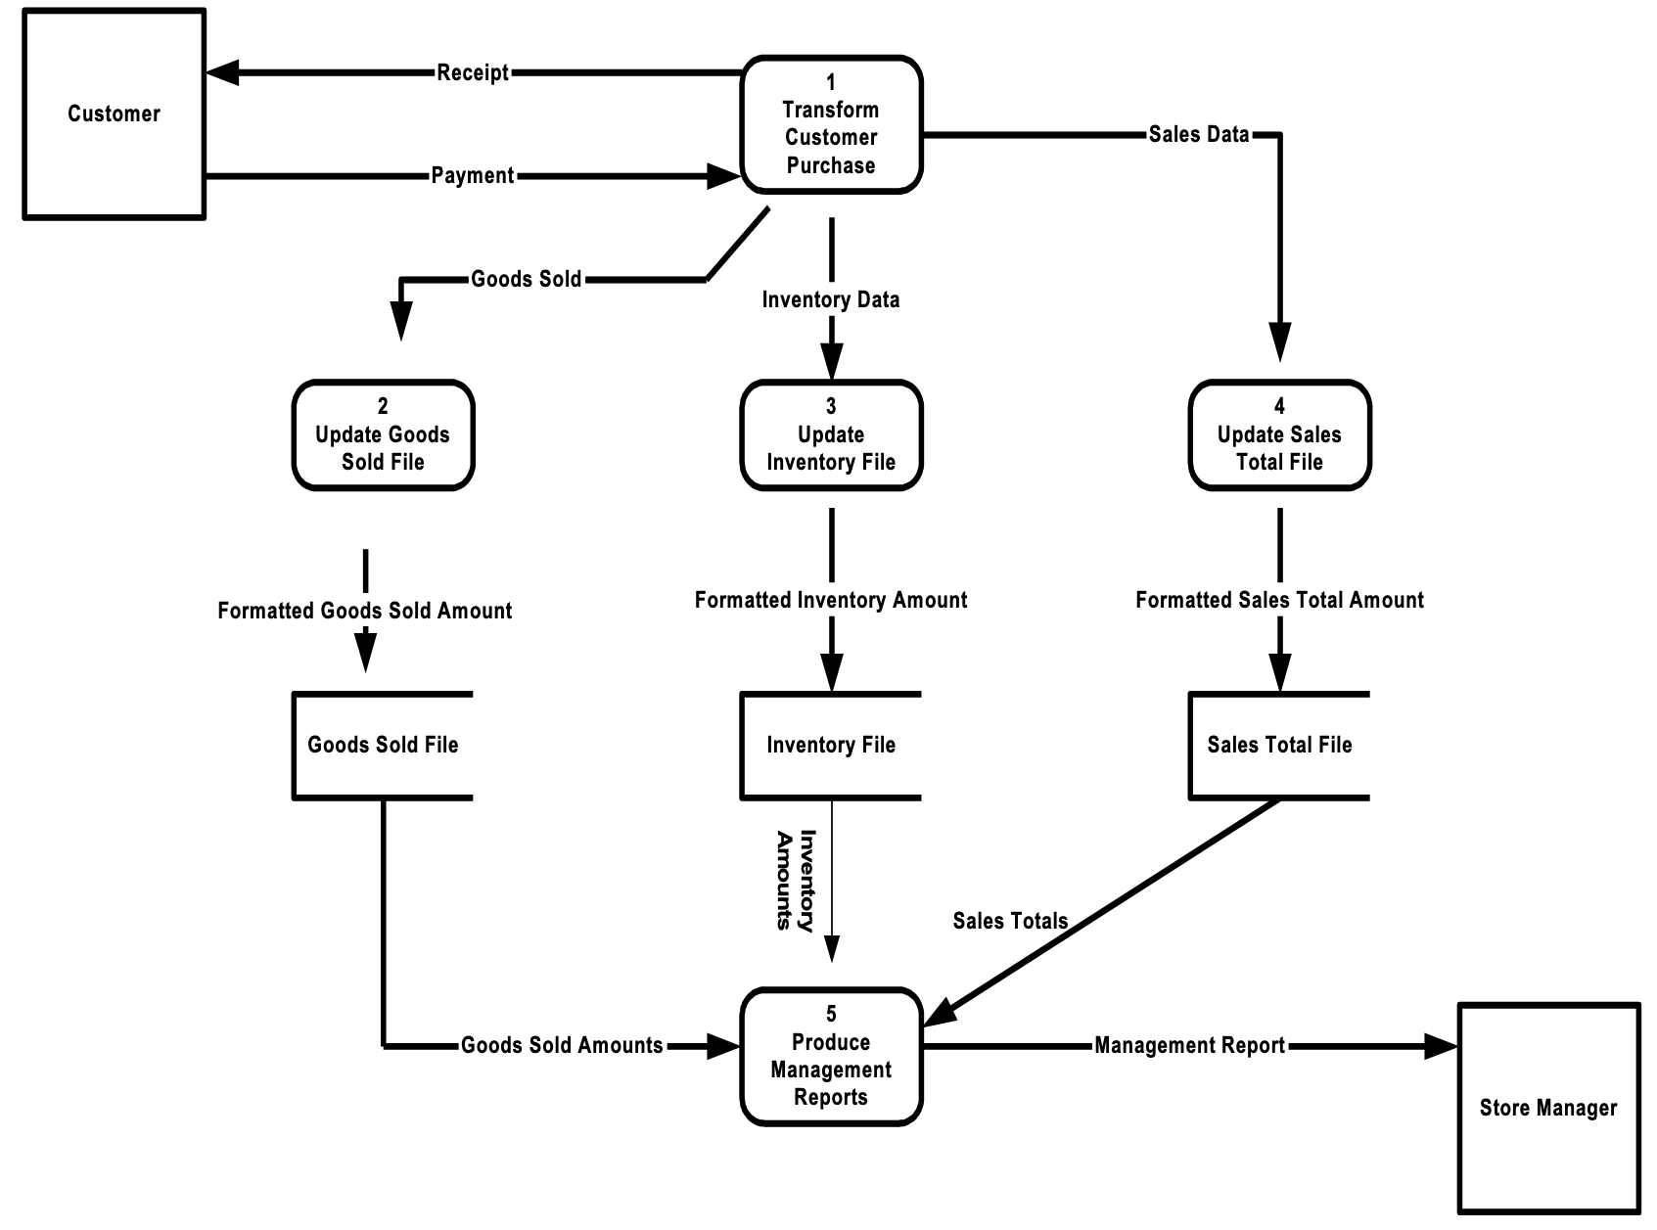
Exercise of DFD
Level 0 Diagram

Slide 36
Exercise of DFD
Starting with a context diagram, draw as many nested DFDs as you consider necessary to represent all the details of the employee hiring system described in the following narrative. You must draw at least a context and a level-0 diagram. In drawing these diagrams, if you discover that the narrative is incomplete, make up reasonable explanations to complete the story. Supply these extra explanations along with the diagrams.
Applicant
Fill up - Non discloser form, a completed application
Receives – blank non disclosure form, notification of interview schedule, and hiring decision letter
Engineering manager
Provides – Interview evaluation, job description
Receives – Qualified Applicant’s application, Interview schedule to be undertaken and hiring decision letter

Slide 37
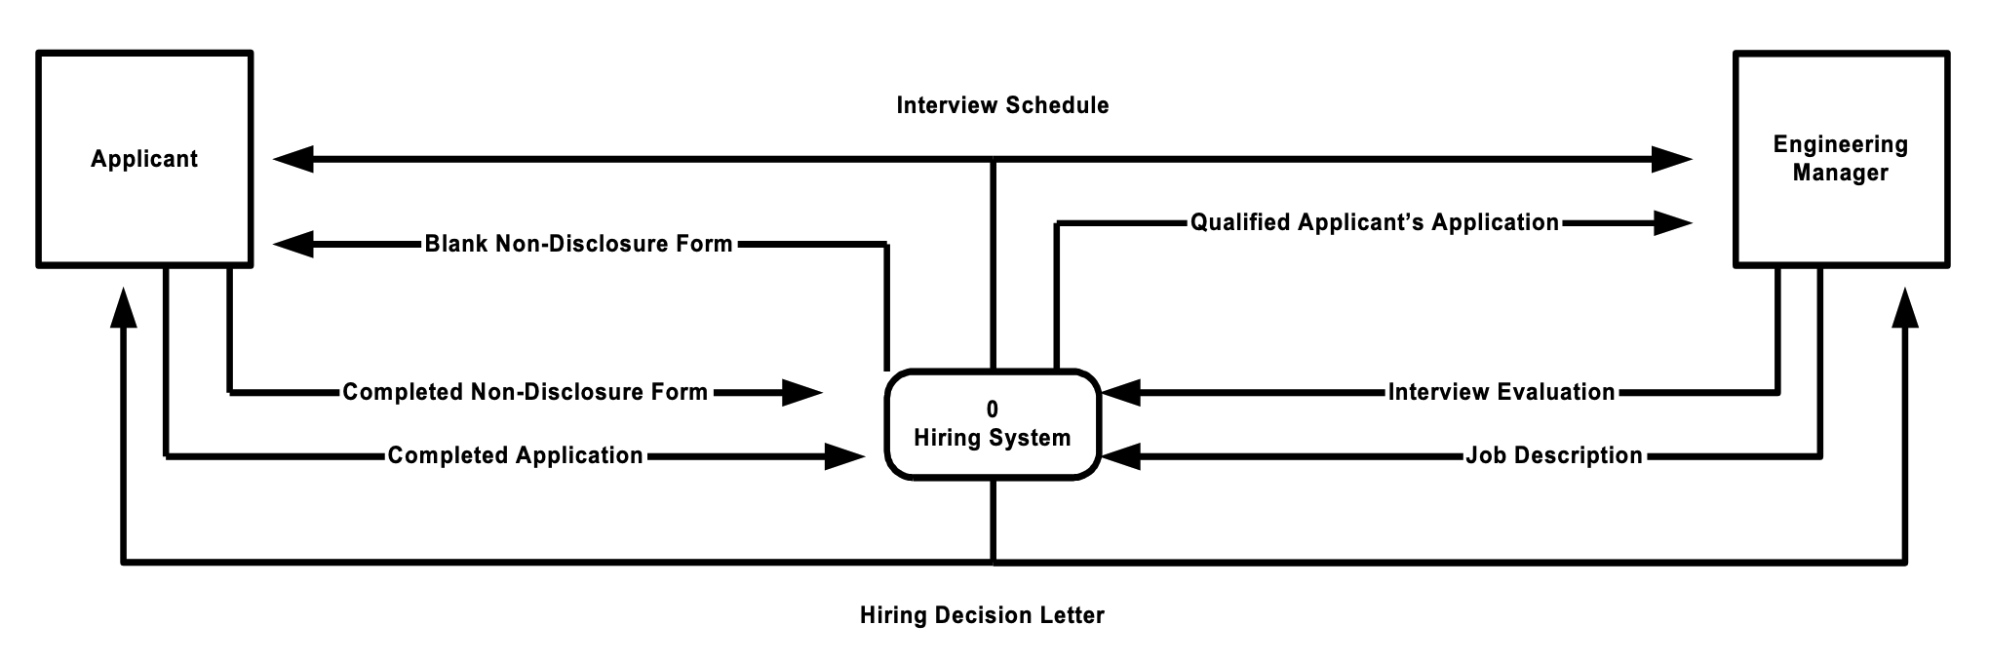
Exercise of DFD
Suggested Context diagram

Slide 38
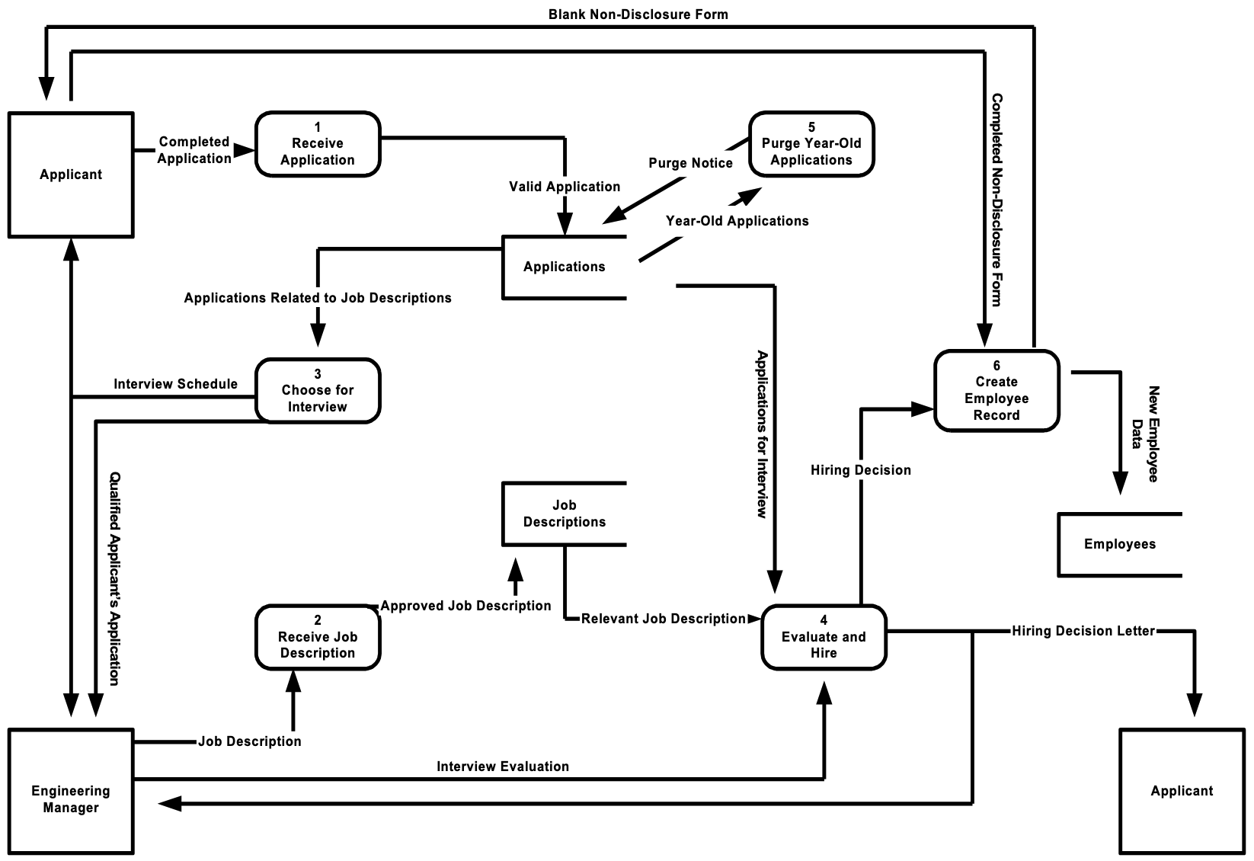
Exercise of DFD
Suggested Level 1 diagram

Slide 39
Exercise of DFD
Create a DFD doctor appointment system. Construct context, level 1 and 2 diagram and system description is as follows
The Doctor Appointment System has to be developed to streamline and enhance the process of scheduling and managing appointments between patients and medical practitioners. This system must offer functionality to patients to view available time slots, select preferred doctors, and book appointments at their convenience. Admin - medical practitioners can manage their schedules, track patient appointments, and efficiently allocate their time. The system aims to reduce waiting times, enhance patient-doctor communication, and improve overall healthcare service delivery.

Slide 40
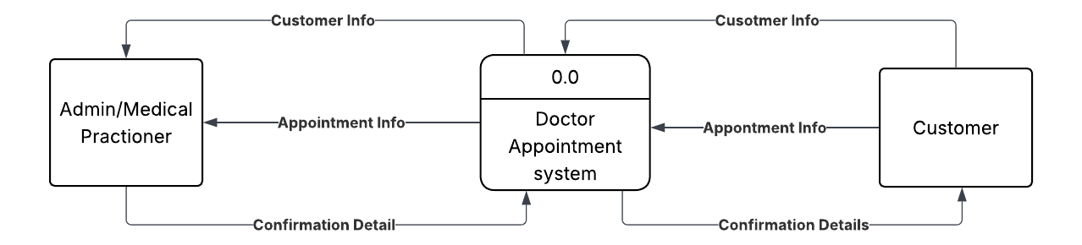
Exercise of DFD
Context diagram of doctor appointment system

Slide 41
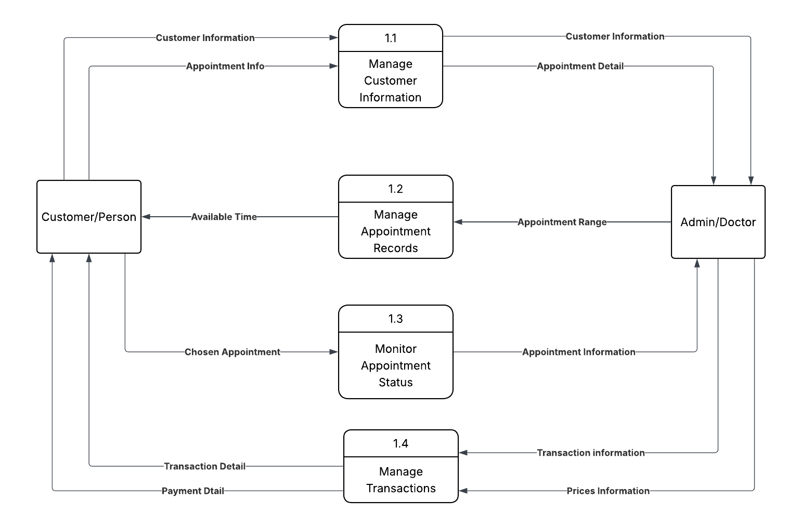
Exercise of DFD
Level 0 diagram of doctor appointment system

Slide 42
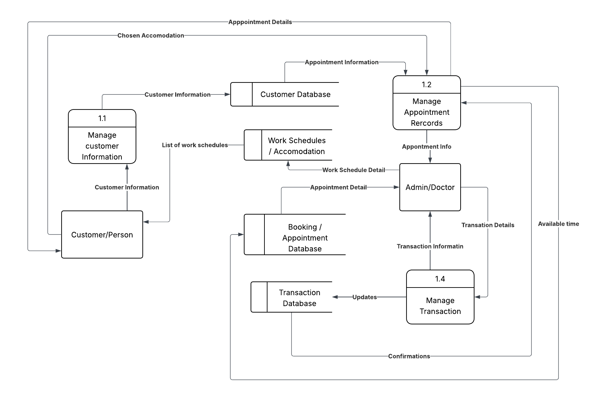
Exercise of DFD
Level 0 diagram of doctor appointment system

Slide 43
Data Model
What is Data model?
Data model is a collection of conceptual tools for describing data, data relationships, data semantics, and consistency constraints.
Data model is a conceptual representation of data structures required for database and is very powerful in expressing and communicating the business requirements,
A data model visually represents the nature of data, business rules governing the data , and how it will be organized in the database.

Slide 44
Data Model
Different of Data model?
Conceptual: describes WHAT the system contains; its just only for proof of concepts
Logical: describes HOW the system will be implemented, regardless of the DBMS; which show the logical organization of data without indicating how data are stored; created or manipulated.
Physical: describes HOW the system will be implemented, with particular database management system; which shows how the data are stored; created and manipulated.

Slide 45
Data Model – Entity Relationship Diagram
What is Entity Relationship Diagram?
An entity relationship diagram (ERD) is a picture which shows the information that is created, stored, and used by a business system. An analyst can read an ERD to discover the individual pieces of information in a system and how they are organized and related to each other.
ER – diagram are capable of communicating high-level business rules those need to be supported by the system

Slide 46
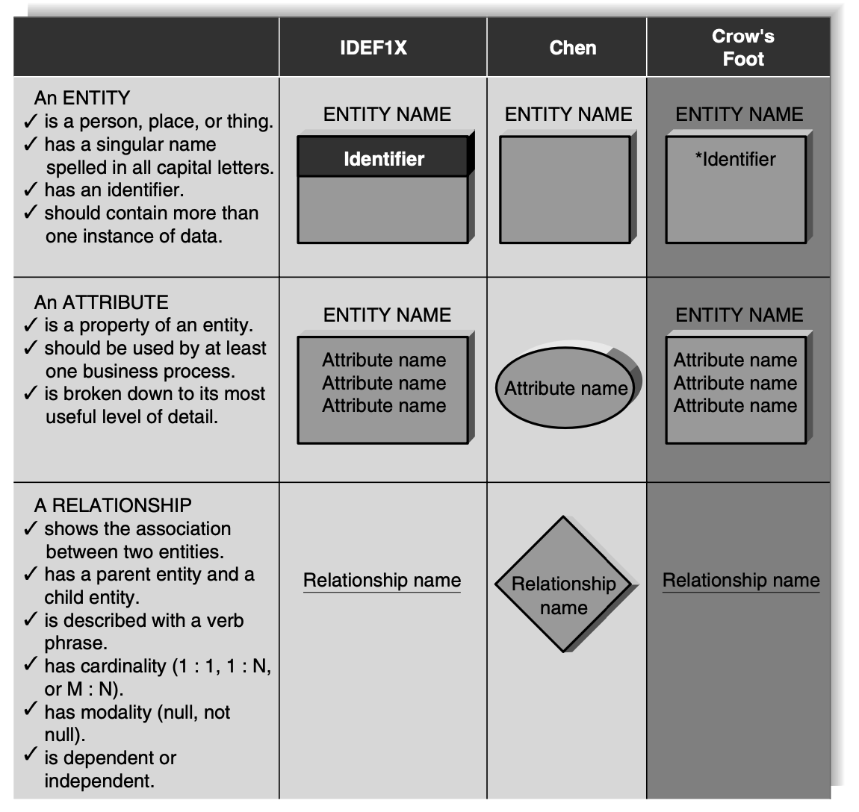
Data Model – Entity Relationship Diagram
Components of ERD

Slide 47
Data Model – Entity Relationship Diagram
Entity
The entity is the basic building block for a data model. It is a person, place, event, or thing about which data is collected—for example, an employee, an order, or a product.
An entity is depicted by a rectangle, and it is described by a singular noun spelled in capital letters
All entities have a name, a short description that explains what they are, and an identifier that is the way to locate information in the entity
Attribute
An attribute is some type of information that is captured about an entity. For example, last name, home address, and e-mail address are all attributes of an employee.
Attributes are nouns that are listed within an entity.
Attributes can be categorized – composite attribute, multivalued, - double lined eclipse weak attribute and derived-dotted eclipse
Multi valued attribute is depicted in double eclipse

Slide 48
Data Model – Entity Relationship Diagram
Relationship
Relationships are associations between entities,
they are shown by lines that connect the entities together.
Every relationship has a parent entity and a child entity, the parent being the first entity in the relationship, and the child being the second.
Cardinality:
Relationships have two properties that convey meaning about the nature of the entity relationship.
A relationship has cardinality, which is the ratio of parent instances to child instances.
1:1 - relationship means that one instance of the parent entity is associated with exactly one instance of the child entity.
1:M(1:N) - a single instance of a parent entity is associated with many instances of a child entity; however, the child entity instance is related to only one instance of the parent.
M:N (M:M) - many instances of an entity can relate to many instances of another entity

Slide 49
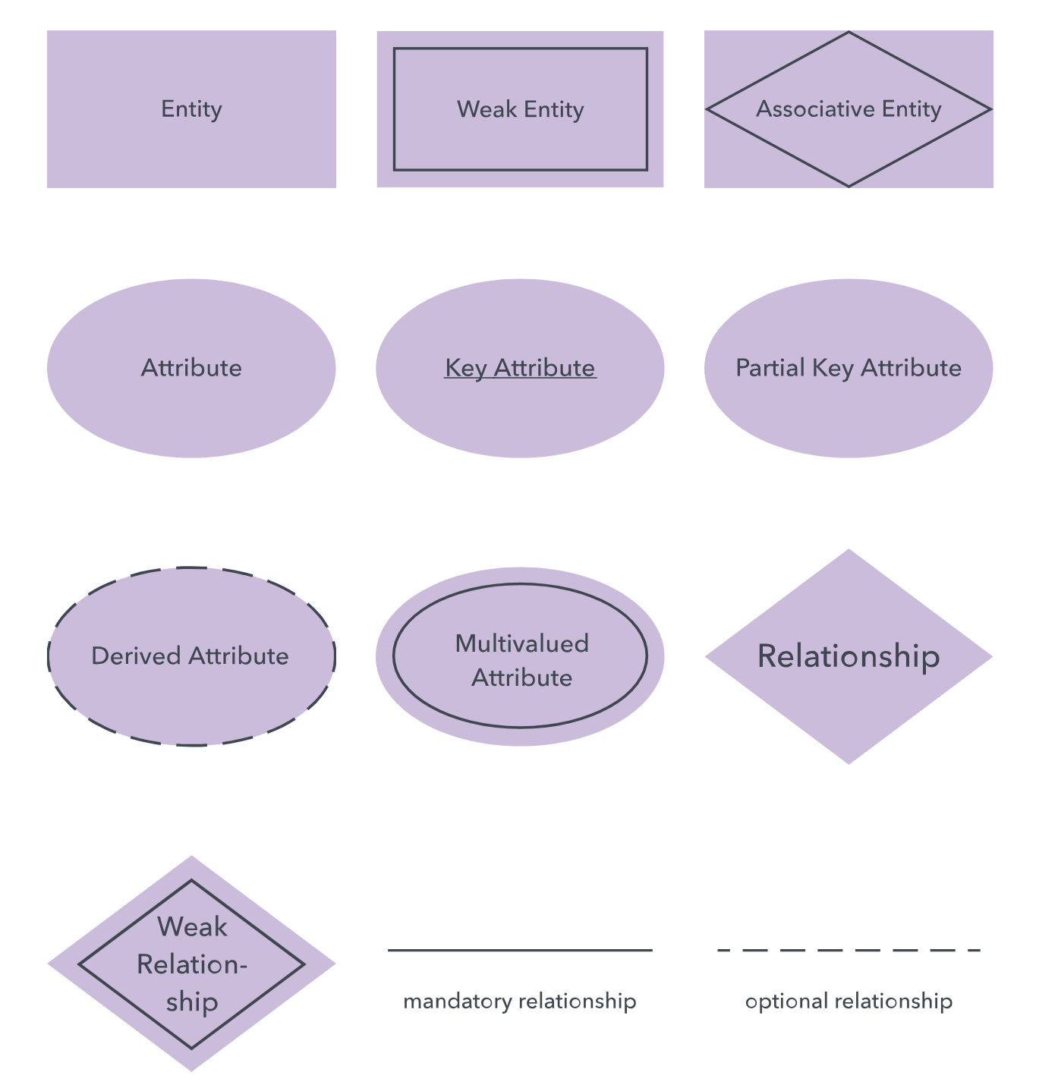
Data Model – Entity Relationship Diagram
Chen Notation

Slide 50
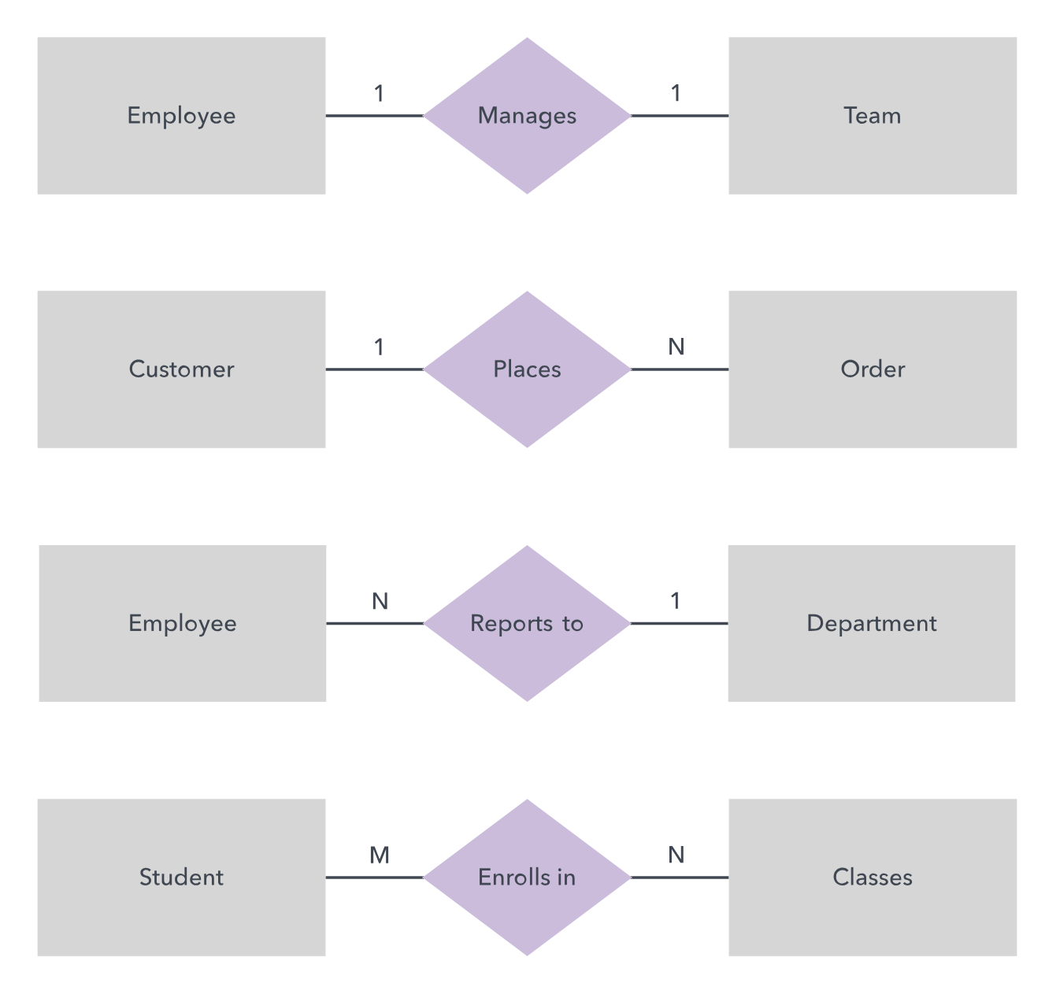
Data Model – Entity Relationship Diagram
Chen Notation

Slide 51
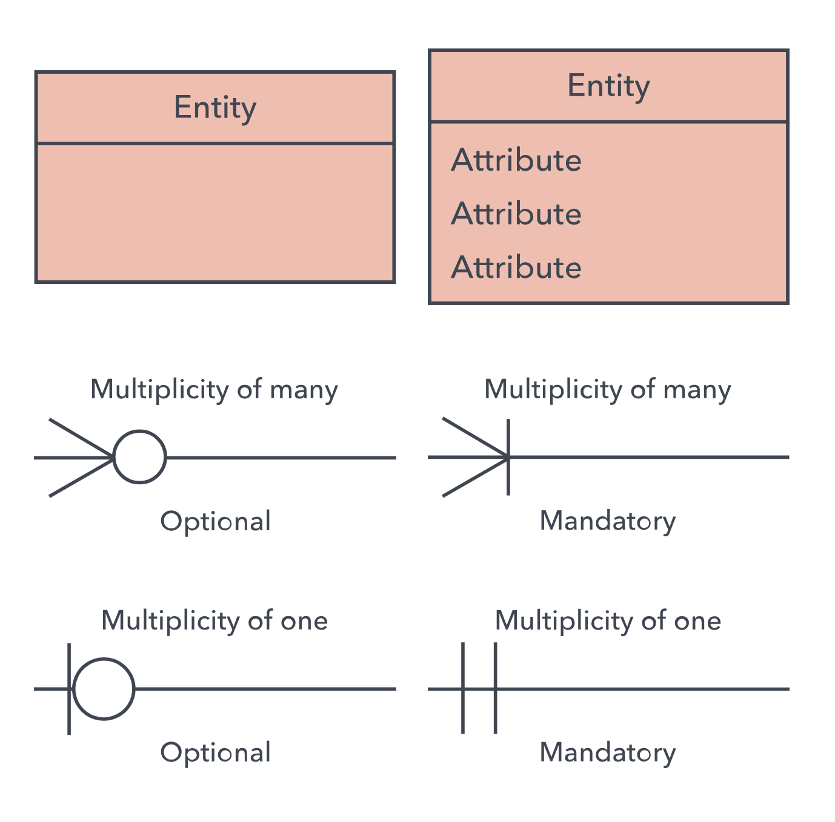
Data Model – Entity Relationship Diagram
Crow’s foot

Slide 52
Data Model – Entity Relationship Diagram
Crow’s foot

Slide 53
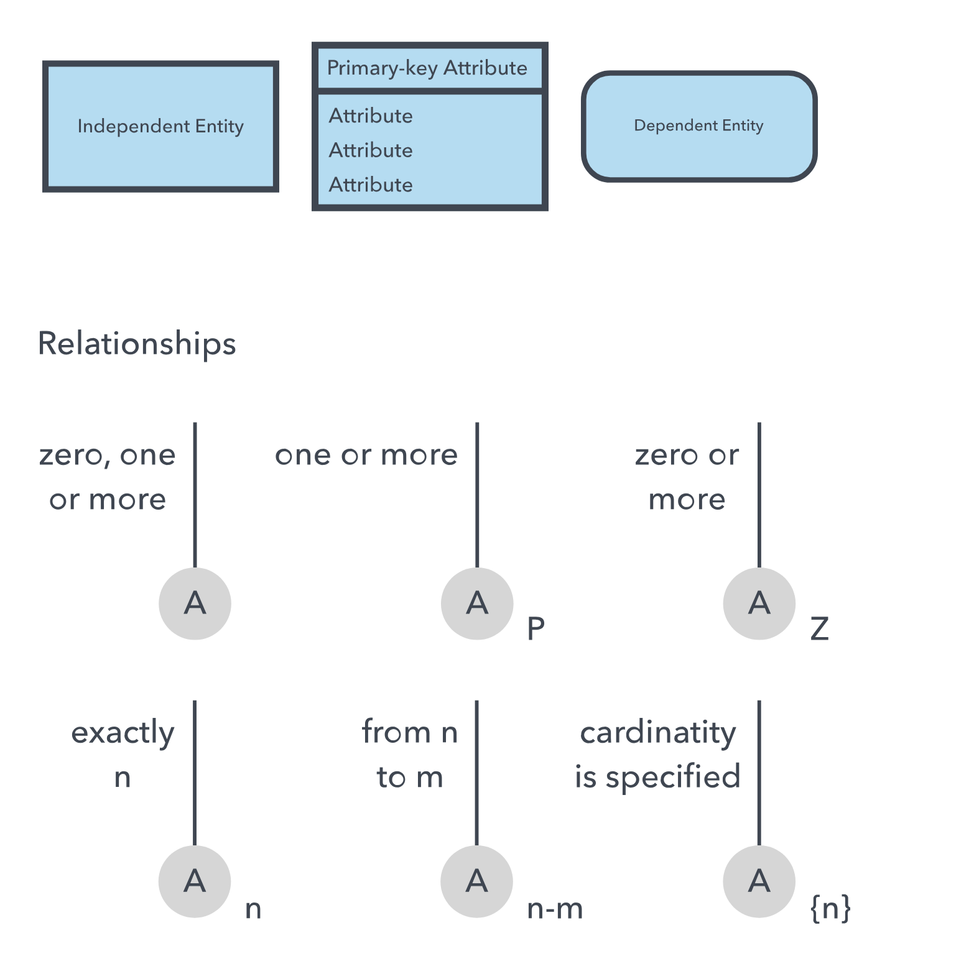
Data Model – Entity Relationship Diagram
IDE1FX foot

Slide 54
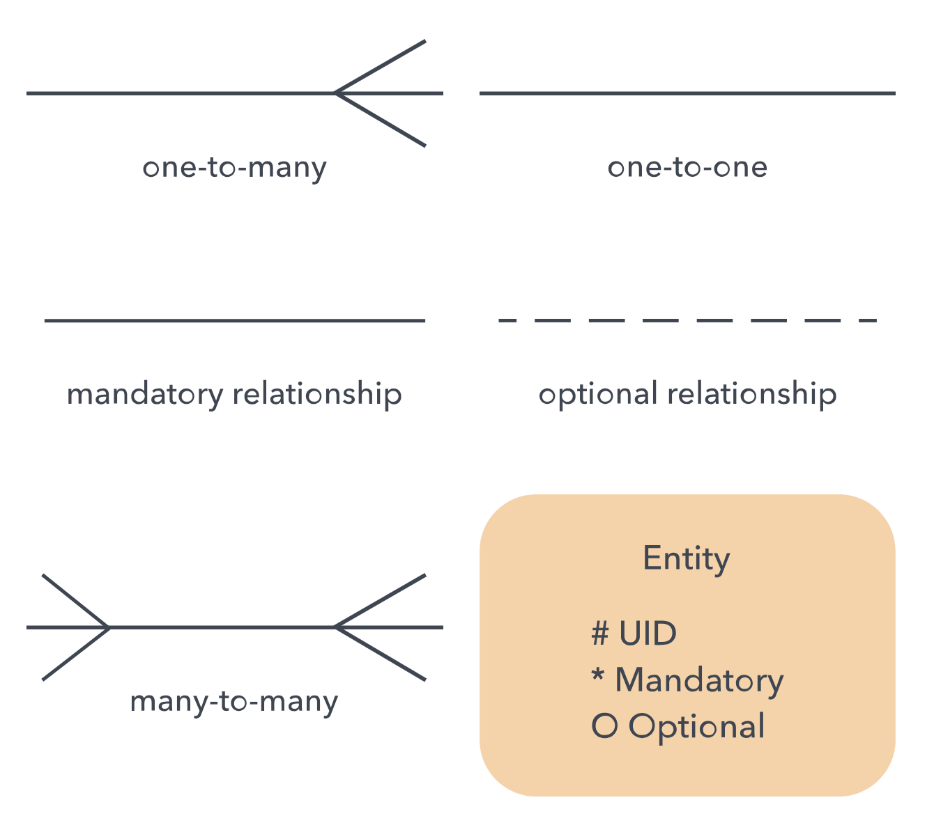
Data Model – Entity Relationship Diagram
Barker Style

Slide 55
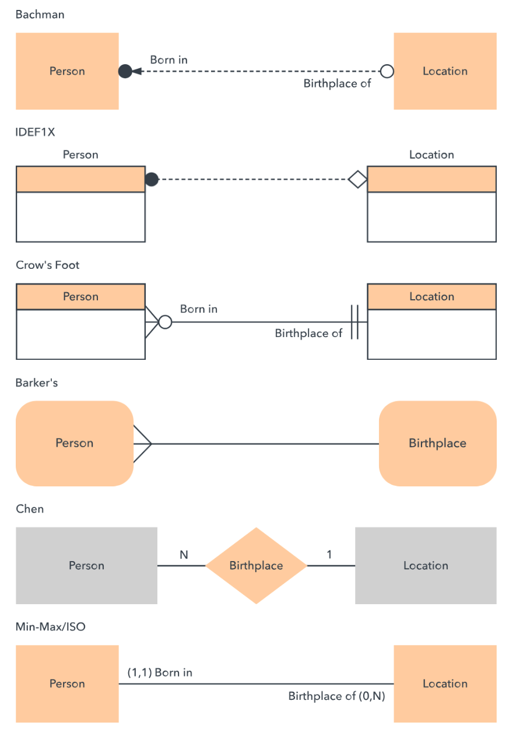
Data Model – Entity Relationship Diagram
Example of each style

Slide 56
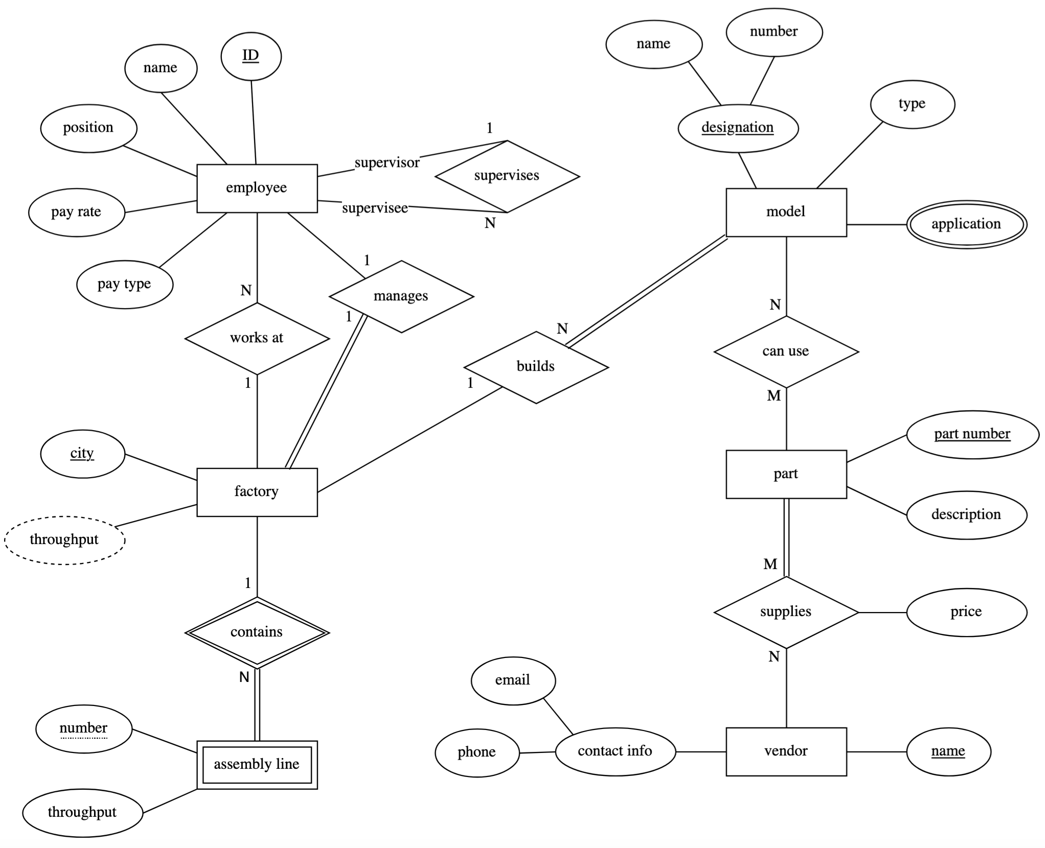
Data Model – Entity Relationship Diagram eg
kjkl

Slide 57
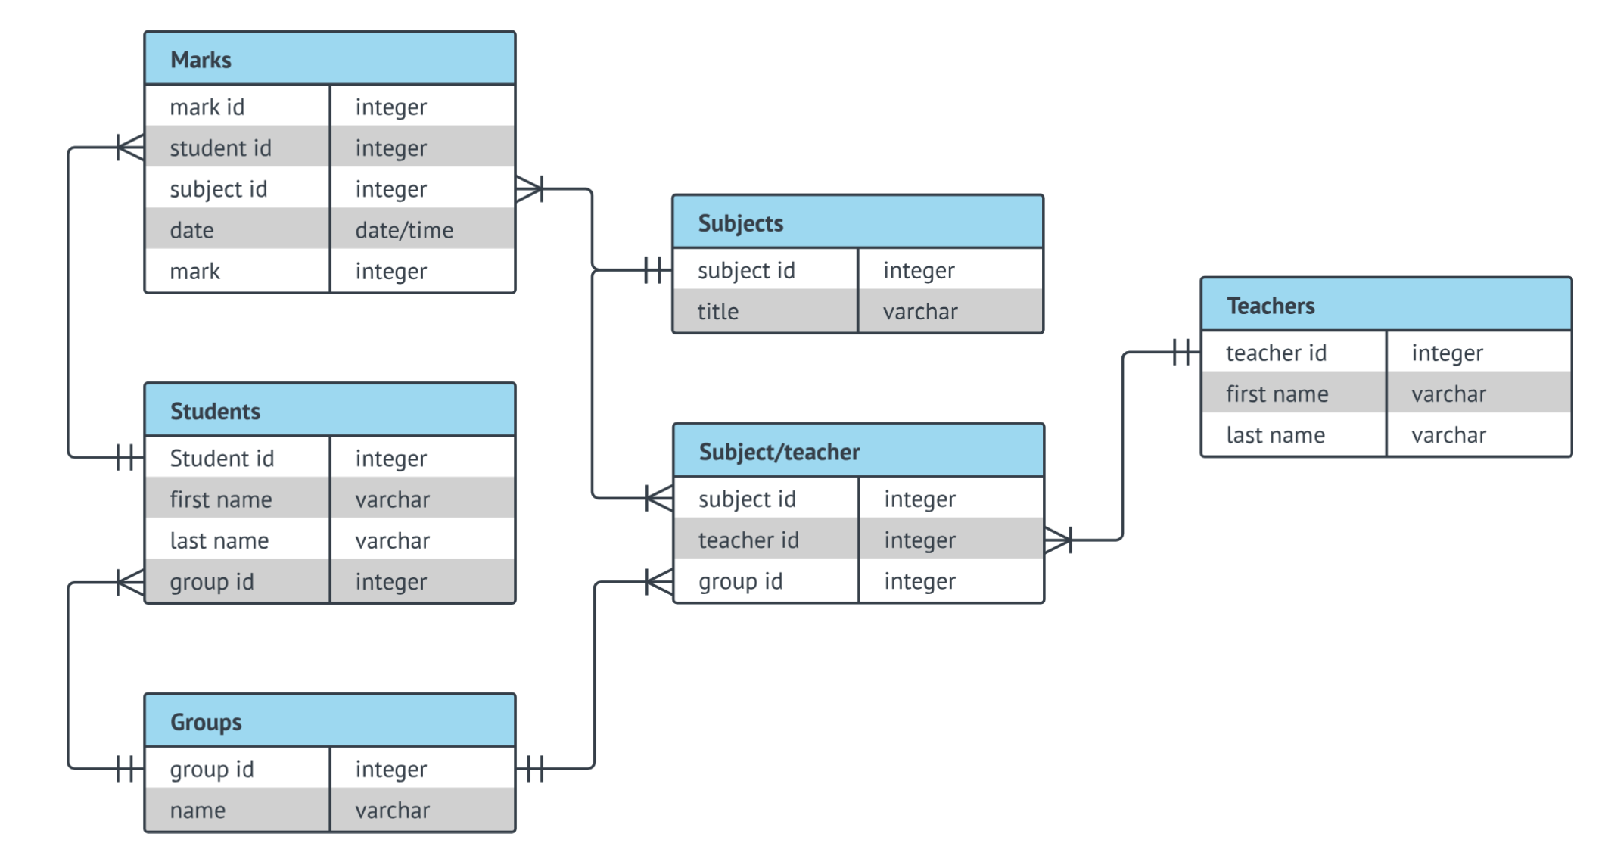
Data Model – Entity Relationship Diagram eg
kjkl

Slide 58
Data Model – Entity Relationship Diagram
Question 1 – Create an ER diagram for following details
UPS prides itself on having up-to-date information on the processing and current location of each shipped item. To do this, UPS relies on a company-wide information system. Shipped items are the heart of the UPS product tracking information system. Shipped items can be characterized by item number (unique), weight, dimensions, insurance amount, destination, and final delivery date. Shipped items are received into the UPS system at a single retail center. Retail centers are characterized by their type, uniqueID, and address. Shipped items make their way to their destination via one or more standard UPS transportation events (i.e., flights, truck deliveries). These transportation events are characterized by a unique scheduleNumber, a type (e.g, flight, truck), and a deliveryRoute.

Slide 59
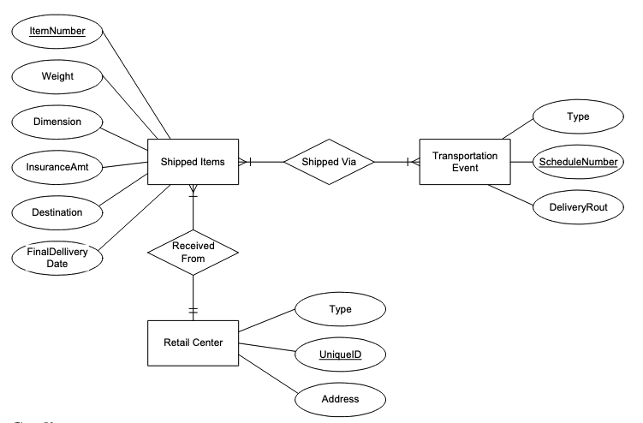
Data Model – Entity Relationship Diagram

Slide 60
Data Model – Entity Relationship Diagram
Question 2 – Create an ER diagram for following details
An automobile insurance company needs to keep track of information about vehicle. The company has to store information of customer, car and accident. Customer information is LicenseNo, name and address. Customers can own one or more cars, where the car information is PlateNo, model and year. A car may or may not involved in many accidents. If the car is involved in an accident, the information that will be stored is Report_number, location and date.

Slide 61
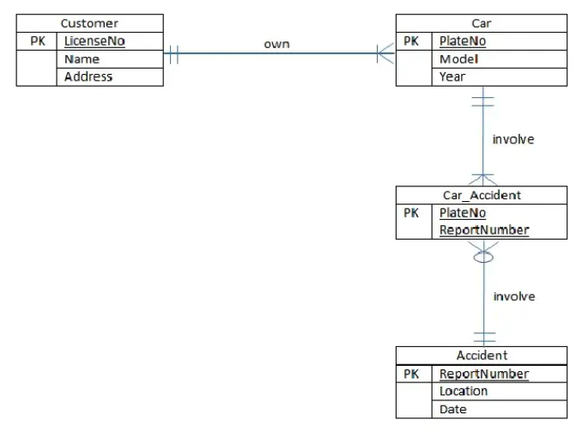
Data Model – Entity Relationship Diagram

Slide 62
Data Model – Entity Relationship Diagram
Question 3 – Create an ER diagram for following details
Create a Crow’s foot ERD that correctly depicts the following requirements: An INVOICE is written by a SALESREP. Each sales representative can write many invoices, but each invoice is written by a single sales representative. The INVOICE is written for a single CUSTOMER. However, each customer can have many invoices. An INVOICE can include many detail lines (LINE), each of which describes one product bought by the customer. The product information is stored in a PRODUCT entity. The product’s vendor information is found in a VENDOR entity. The ERD must reflect business rules that you are free to define (within reason). Make sure that your ERD reflects the conditions you require. Finally, make sure that you include the attributes that would permit the model to be successfully implemented.

Slide 63
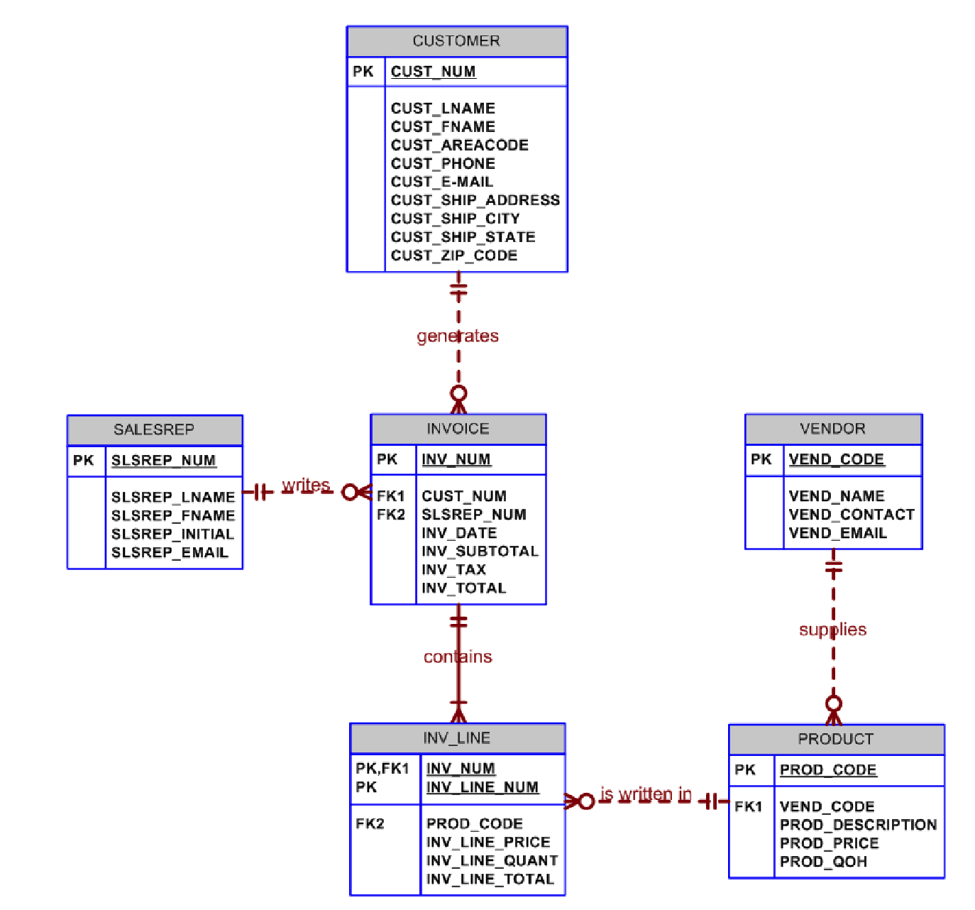
Data Model – Entity Relationship Diagram

Slide 64
Data Model – Normalize ERD
Data modeling is an iterative process. Generally a preliminary data model is constructed which is then refined many times. There are many guidelines (rules) for refining an ERD. Some of these rules are as follows (Mannino, 2006):
Transform attributes into entity types. This transformation involves the addition of an entity type and a 1-M (one-to-many) relationship.
Split compound attributes into smaller attributes. A compound attribute contains multiple kinds of data.
Expand entity types into two entity types and a relationship. This transformation can be useful to record a finer level of detail about an entity. For example addresses or contacts
Transform a weak entity type into a strong entity type. This transformation is most useful for associative entity types.
Add historical details to a data model. Historical details may be necessary for legal as well as strategic reporting requirements. This transformation can be applied to attributes and relationships.
Add generalization hierarchies by transforming entity types into generalization hierarchy.

Slide 65
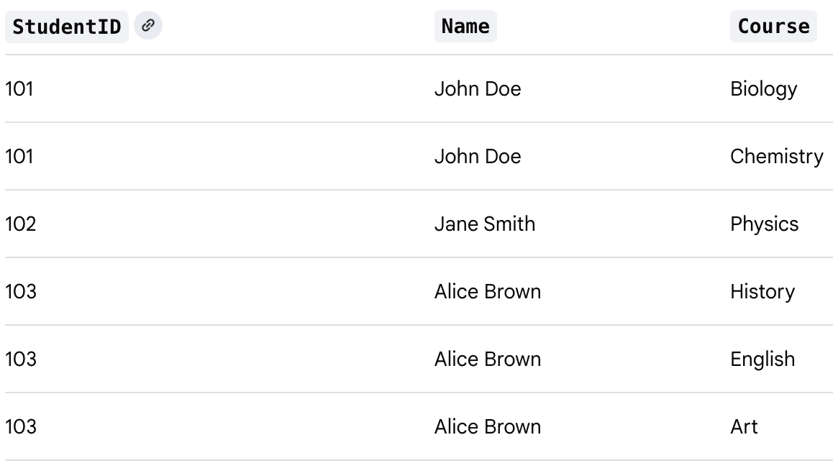
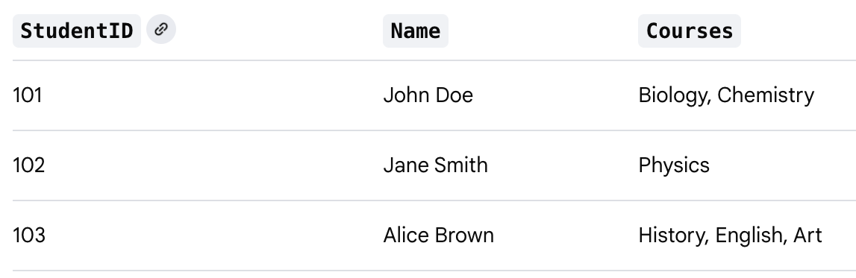
Data Model – Normalize ERD
Normal forms
First Normal Form (1NF) The first normal form rule is that there should be no nesting or repeating groups in a table. Now an entity type that contains only one value for an attribute in an entity instance ensures the application of first normal form for the entity type.
a single cell must not hold more than one value (atomicity)
there must be a primary key for identification
no duplicated rows or columns
each column must have only one value for each row in the table
Aim is to make it easier to query and manage

Slide 66
Data Model – Normalize ERD
Normal forms
Second Normal Form (2NF) The second normal form rule is that the key attributes determine all non-key attributes. A violation of second normal form occurs when there is a composite key, and part of the key determines some non-key attributes. The second normal form deals with the situation when the entity identifier contains two or more attributes, and the non-key attribute depends on part of the entity identifier.
it’s already in 1NF
has no partial dependency. That is, all non-key attributes are fully dependent on a primary key.

Slide 67
Data Model – Normalize ERD
Normal forms
Third Normal Form (3NF) The third normal form rule is that the non-key attributes should be independent. This normal form is violated when there exists a dependency among non-key attributes in the form of a transitive dependency.
be in 2NF
have no transitive partial dependency.

Slide 68
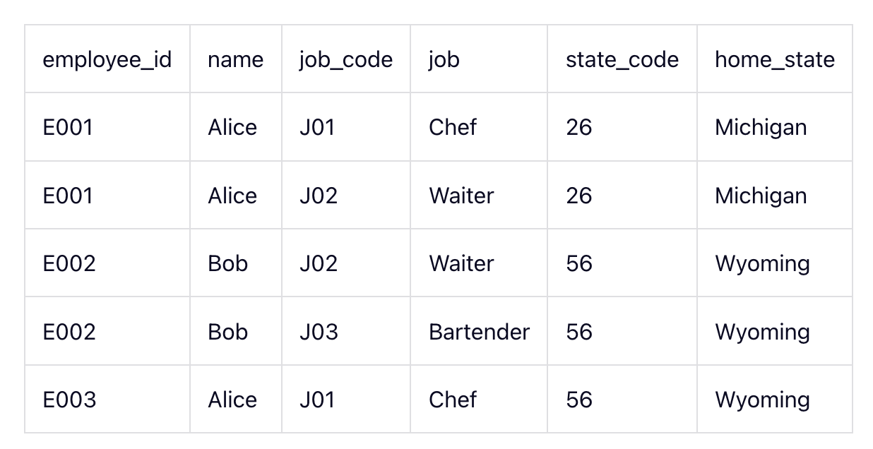
Data Model – Normalize ERD
All the entries are atomic and there is a composite primary key (employee_id, job_code) so the table is in the first normal form (1NF).
But even if you only know someone's employee_id, then you can determine their name, home_state, and state_code (because they should be the same person). This means name, home_state, and state_code are dependent on employee_id (a part of primary composite key). So, the table is not in 2NF. We should separate them to a different table to make it 2NF.
Normal forms

Slide 69
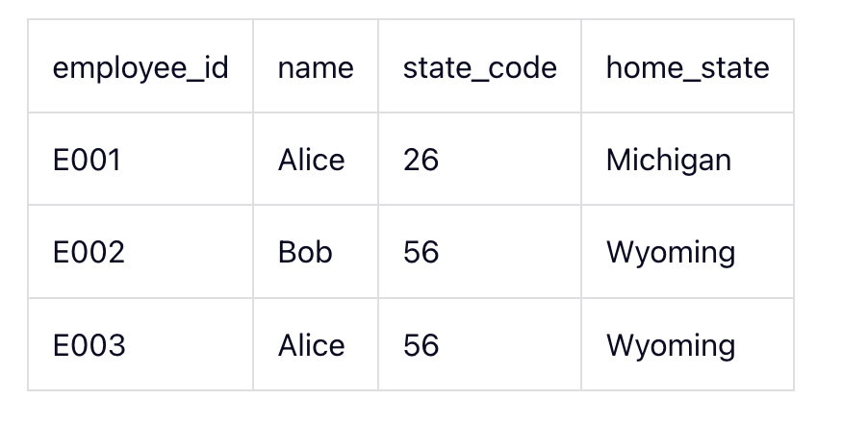
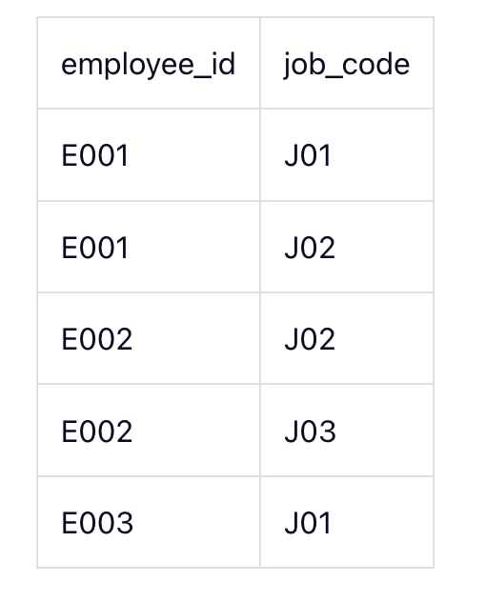
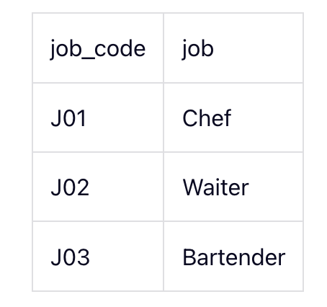
Data Model – Normalize ERD
Normal forms
home_state is now dependent on state_code. So, if you know the state_code, then you can find the home_state value.
To take this a step further, we should separate them again to a different table to make it 3NF.

Slide 70
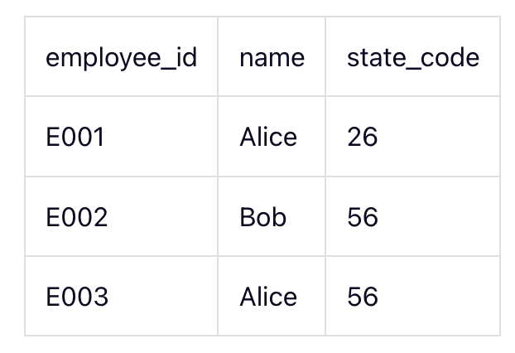
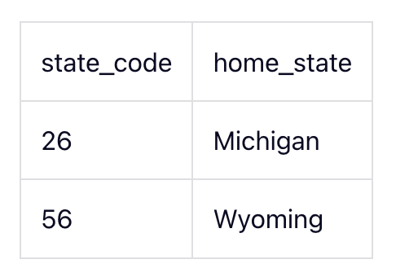
Data Model – Normalize ERD
Normal forms

Slide 71
Data Model - Data Dictionary
Data Dictionary and Meta data
A data dictionary is a document that stores metadata for a database, including the metadata for an entity relationship diagram (ERD)
How are data dictionaries and ERDs related?
A data dictionary can provide metadata for an ERD
An ERD can be used to model the database components that are described in a data dictionary

Slide 72
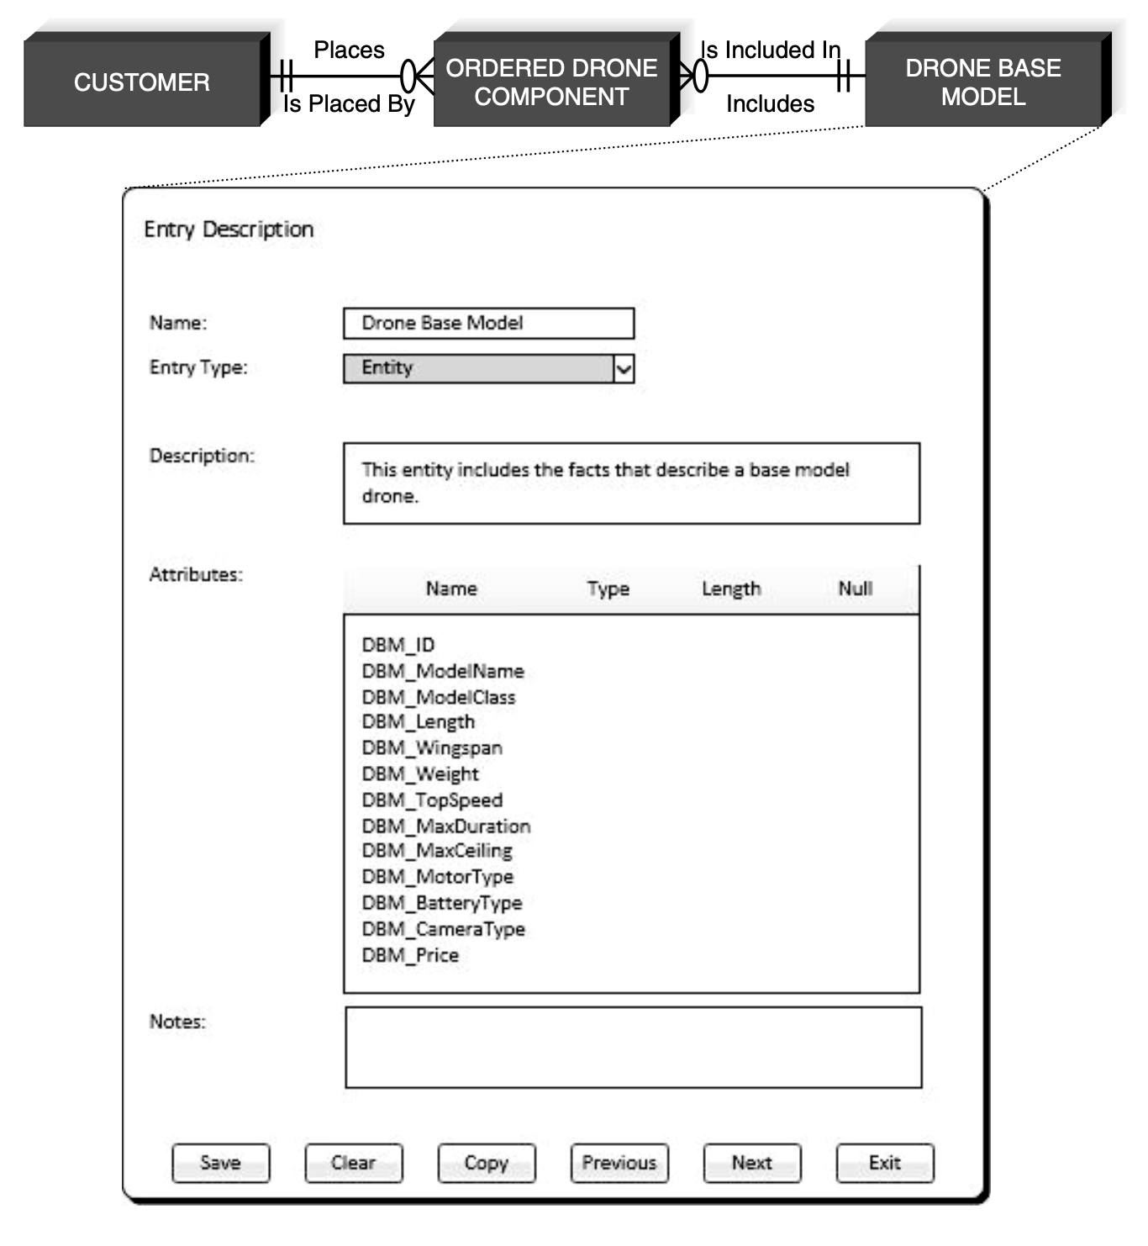
Data Model - Data Dictionary
Data Dictionary and Meta data

Slide 73
Hmmmm..
That’s end of Unit IV
Thank you

